Slide 1
Smart Poultry farm controlling system using Arduino UNO

Slide 2
Introduction
This project attempts to help farmers that are already able to supply chickens or eggs for sales in medium size markets of which a significant amount consists of farmers that did not get formal education on poultry farming. The device comes equipped with a temperature, humidity and light intensity sensors. This is because the biggest challenges experienced by poultry farmers are:
Birds die due to heat/cold stress. Since no one can keep an eye 24/7 on them, farmers mostly find these birds the following day when its already late.
Humidity can result in a rapid spread of disease within the poultry house. So, it needs to be monitored also.

Slide 3
WORKING PRINCIPLE
We use DHT22 sensor to measure temperature and humidity. We use if statement to check and control temperature of the poultry farm. When DHT sensor start to give data to Arduino it will display data on Using keypad, case will select, and Arduino will proceed task under given condition in case.
This syestem autometically do performs for checking temperature, checking humidity, control fan using dc motor.
When teperature is high the dc motor will start and when low the dc motor will stop.
Aotumatically close dor and window. etc

Slide 4
Components Required
Arduino UNO
Ultrasonic sonar Sensor
Temperature sensor
Gas sensor
Servo Motor
DC motor
Buzzer
Led Light
Connecting Wires
5V Power Supply
glue, plastic tube, etc

Slide 5
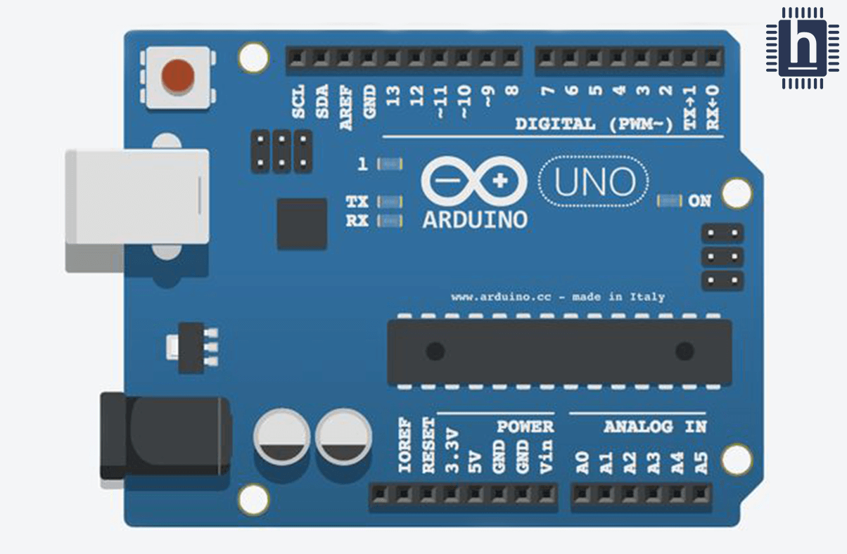
Arduino UNO
Arduino UNO is a low-cost, flexible, and easy-to-use programmable open-source microcontroller board that can be integrated into a variety of electronic projects. This board can be interfaced with other Arduino boards, Arduino shields, Raspberry Pi boards and can control relays, LEDs, servos, and motors as an output

Slide 6
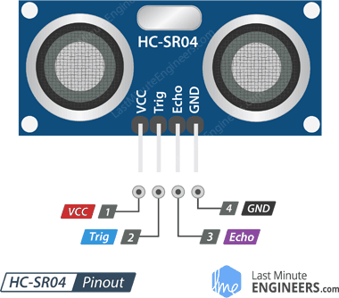
Ultrasonic sonar sensor
An ultrasonic sensor is an electronic device that measures the distance of a target object by emitting ultrasonic sound waves, and converts the reflected sound into an electrical signal. Ultrasonic waves travel faster than the speed of audible sound ( the sound that humans can hear)

Slide 7
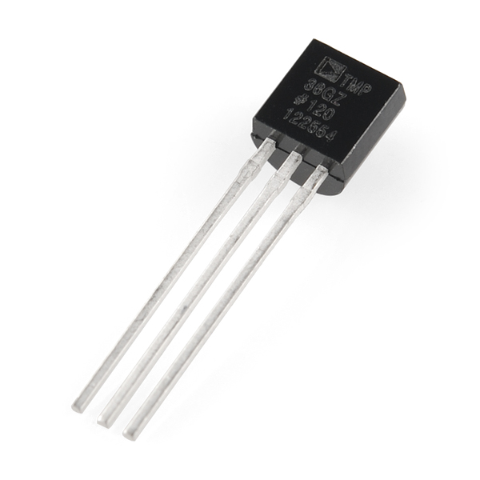
Temperature sensor
A temperature sensor is an electronic device that measures the temperature of its environment and converts the input data into electronic data to record, monitor, or signal temperature changes.

Slide 8
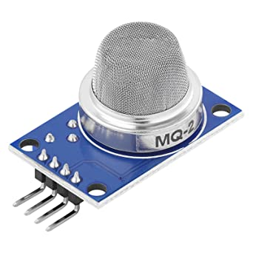
Gas sensor
Gas sensors are devices that can detect the presence and concentration of various hazardous gases and vapors, such as toxic or explosive gases, volatile organic compounds (VOCs), humidity, and odors

Slide 9
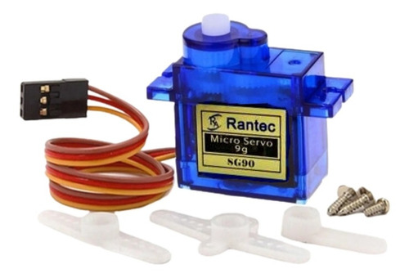
Servo Motor
Servo motors are known, are electronic devices and rotary or linear actuators that rotate and push parts of a machine with precision. Servos are mainly used on angular or linear position and for specific velocity, and acceleration.

Slide 10
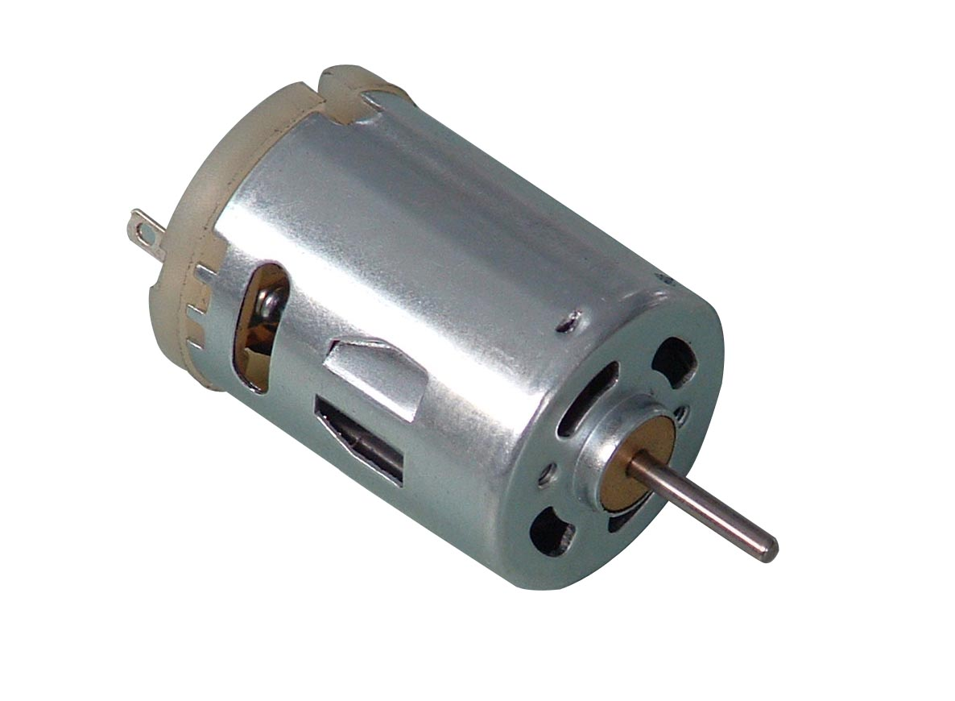
DC Motor
A DC motor is any of a class of rotary electrical motors that converts direct current (DC) electrical energy into mechanical energy.

Slide 11

Application of Arduino UNO
The open-source Arduino Software (IDE) makes it easy to write code and upload it to the board. It runs on Windows, Mac OS X, and Linux. The environment is written in Java and based on Processing and other open-source software. This software can be used with any Arduino board. This requires basic knowledge of C programming language.

Slide 12
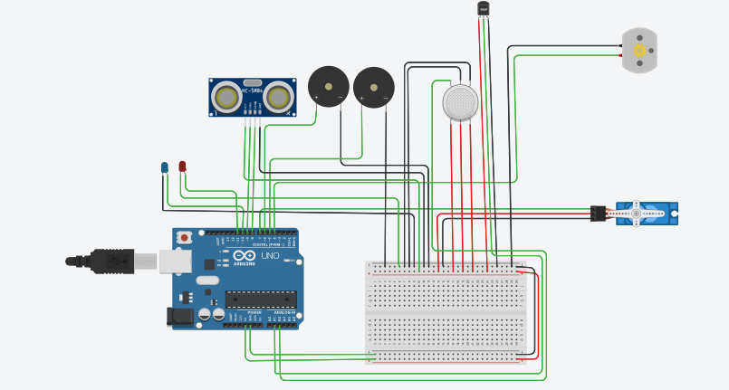
Circuit Diagram

Slide 13
Live Project
https://www.tinkercad.com/things/9VOINKHQQMM-final-poultry-farm/editel

Slide 14
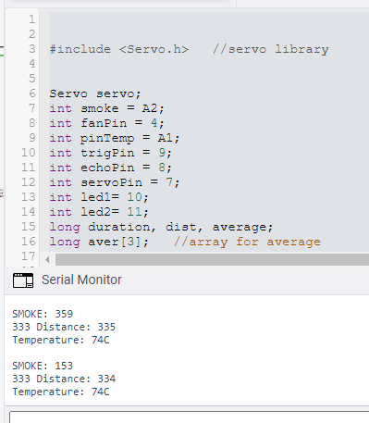
Project Code

Slide 15
Advantages
We can monitor the whole farm easily.
The system will control the farm automatically.
The system will regularly check the Temperature, humidity.
System will take any action automatically when needed.

Slide 16
Limitation
The system Can not take any action for feeding or watering.
The system can be lost for any hardware issue.

Slide 17
In Future
We have the idea for feeding in the farm
In future we will update our system in this features.

Slide 18
Conclusion
A simple but useful project called Smart poultry farm controlling system using Arduino is designed and developed here. Using this project, the poultry farm will develop a lot.

Slide 19
Thank You

